Slide 1
Lecture 17 – Systems Management Processes

Slide 2
Overview
This lecture is a set of odds and ends
They are things that you need to know about
They are things that other courses might spend a lot of time on
They tend to be more process based than technical
My rubric for topics here has been to give you a top level introduction to any topics that we haven’t previously discussed that would be considered as mandatory knowledge for a systems engineer
  I don’t want anyone to turn to you and say “I thought you said that you took systems engineering?”

Slide 3
Overview
The two halves of systems engineering
Systems Engineering Management Plan (SEMP)
Capability Maturity Model Integration (CMMI)
Change/Configuration Control
Key Performance Parameters (KPP) and Technical Performance Metrics (TPMs)
Master Verification Plan

Slide 4
Systems Engineering Management Plan (SEMP)
My experience:
  If you don’t have one, people will insist that you have one
  If you do have one, and senior management doesn’t want to follow it, they probably won’t
  At best, it provides you a mechanism for you to think through how you would like to work
  At worst, it is another piece of administrative paperwork
Some people think it is absolutely critical
    Shuttle Return to Flight was hung up by Stafford Covey until we wrote one
    The ink wasn’t even dry when people started running all over it
My advice: minimize the parts that don’t add value and maximize the engineering value and use it to get your own thinking straight

Slide 5
Systems Engineering Management Plan (SEMP) – The basics
Foreword
Contents
1. SCOPE
2. APPLICABLE DOCUMENTS
3. TECHNICAL PROGRAM PLANNING AND CONTROL
4. SYSTEMS ENGINEERING PROCESS
5. ENGINEERING SPECIALTY INTEGRATION
6. NOTES
http://sparc.airtime.co.uk/users/wysywig/semp.htm

Slide 6
SEMP - Technical Program Planning and Control
Technical program planning and control identifies organizational responsibilities and authority for system engineering management, including control of subcontracted engineering:
  levels of control established for performance and design requirements and control of the method used;
  technical program assurance methods (verification-ITAD);
  plans and schedules for design and technical program reviews;
  control of documentation;
  design approval and certification;
Bottom line – describe how you are going to control the engineering requirement and development process

Slide 7
SEMP – Systems Engineering Process
This section contains a detailed description of the process to be used, including the specific tailoring of the process to the requirements of the system and project:
  the procedures to be used in implementing the process;
  in-house documentation;
  the trade study methodology;
  the types of mathematical and/or simulation models to be used for system and cost effectiveness evaluations;
  and the generation of specifications
Bottom line : describe the tools and methodologies you are going to use

Slide 8
SEMP – Engineering Specialty Integration
The integration and coordination of the program efforts for engineering specialty areas (structures, software, avionics, GN&C, mechanisms, electrical power, hydraulics, etc…), to achieve a best mix of the technical/performance values incorporated in the contract, shall be described with the detailed specialty program (project) plans being summarized and/or referenced, as appropriate.
The specialty efforts and parameters will be integrated into the system engineering process at each iteration. The process will be described and considerations taken defined.
You may have to reduce the performance or capabilities of one part of the system in order to maximize the total performance of the system
  For example, you might have to reduce the cargo carrying capacity of the system in order to reduce weight enough to meet range
  You might have to reduce passenger volume in order to make room for fuel or cargo
Bottom line: describe how you are going to integrate different technical disciplines

Slide 9
Change or Configuration Control

Slide 10
Change and Configuration Management
If you are going to have an orderly design and development process with many designers working simultaneously, change or configuration management (control) is critical
Uncoordinated change can create havoc in a development
Uncontrolled change can have large impacts to a project’s ability to maintain cost, schedule or other technical performance goals such as weight
Once a baseline has been established at a milestone (such as a design review) then it is critical that ALL CHANGES to that baseline are reviewed for technical, cost and schedule impact and communicated to all affected parties
  Changes need to be approved by the responsible official – typically the chief engineer and the project/program manager
This review and approval typically takes place at a Configuration Control Board (CCB) where representatives of all of the key organizations are present
  The change is documented on a Change Request (CR) form with attached presentations and engineering products such as drawings
  A presentation is normally made by the person/organization proposing the change
Once approved, paper is signed to authorize a change to drawings, ICDs or other engineering products, to change allocation of moneys or to change schedules
CCB’s may issue actions to gather additional data prior to making a decision or to initiate subsequent changes

Slide 11
A Guide to Successfully Running/Presenting to CCBs
When presenting to a CCB
  Make a clear and complete statement of the problem you are trying to solve
  Make a clear and complete statement of your proposed solution and it’s entire impact
  Try to understand the potential impacts and discuss the change with people and organizations that are impacted by the change ahead of time
  Keep to the topic on hand
  Just the facts
When running a CCB
  Hold them regularly
  Listen carefully, ask lots of questions
  Know what your budget and schedule flexibilities are before you commit
  Gather reasonable data and then MAKE A DECISION – don’t keep sending people back for more data or more options

Slide 12
Systems Engineering Capability Maturity Model Integration (CMMI)

Slide 13
CMM
The Capability Maturity Model (CMM) is a way to develop and refine an organization's processes. The first CMM was for the purpose of developing and refining software development processes. A maturity model is a structured collection of elements that describe characteristics of effective processes. A maturity model provides:
a place to start
the benefit of a community’s prior experiences
a common language and a shared vision
a framework for prioritizing actions
a way to define what improvement means for your organization.
A maturity model can be used as a benchmark for assessing different organizations for equivalent comparison. The model describes the maturity of the company based upon the project the company is handling and the related clients.
The software CMM was generalized into a systems engineering CMM and then rewritten as the CMMI
This standard has been developed and maintained by Carnegie Mellon University
Courtesy of Wikipedia

Slide 14
Levels of CMMI
Level 1 – Initial - can do systems engineering, depends on quality of people, hit or miss
Level 2 – Repeatable – can repeat the process (e.g. write requirements, do a PDR, CDR, etc…)
Level 3 – Defined – procedures are well documented
Level 4 – Quantitatively Managed – metrics are maintained to evaluate how well you are doing
Level 5 – Optimized – you use metrics to identify problems and apply resources to maximize the positive outcome

Slide 15
Value of CMMI
Important for self-evaluation – how are you doing ?
  I initiated a CMMI audit of Shuttle Systems Engineering and Integration after I took over after the accident
  It identified the key weaknesses
  With limited resources at our disposal, I focused our efforts on fixing the key weaknesses found by the audit rather than trying to fix everything
You can use it to help you continuously improve
Unfortunately, People use it as a gimmick
  “we’re level 4….”
  You can almost hear them saying “nyaah,nyaah,nyaah,nyaah”
To go to the source on CMMI, reference
  http://www.sei.cmu.edu/cmmi/

Slide 16
Key Performance Parameters (KPP) and Technical Performance Metrics (TPMs)

Slide 17
KPPs and TPMs
Key Performance Parameters (KPPs)
  Are the values that a system must attain to meet its most important requirements
  Example of key performance parameters would be
    Range
    Cargo/Passengers
  The DOD often goes beyond establishing a requirements specification by actually prioritizing the requirements. The prioritization is accomplished by defining what is called Key Performance Parameters (KPP), which are requirements that are so critical to the program, that the failure to meet any KPP would be grounds for program termination.

Slide 18
KPPs and TPMs
Technical Performance Metrics
  Are the values expressing how well a system is moving towards meeting its KPPs
  , it needs to measure something of importance to the program--a KPP that is essential to proper system operation in order to meet a mission requirement. Some programs may track a few of these TPMs or maybe a few dozen.
  Contractors may have many more TPMs in order to track derived requirements and to ensure proper technical progress toward major system requirements.
  A typical KPP may be system or subsystem weight. A weight TPM may have an objective (defined as the goal or required value at the end of the technical effort) or both an objective and a threshold (defined as the limiting acceptable value that if not met can jeopardize the project).
  A TPM can also have tolerance bands that show the allowed variation, which is based on the projected estimation

Slide 19
Master Verification Plan

Slide 20
Master Verification Plan (MVP)
Identifies the set of facilities and major test environments to verify requirements
May show relationship between test and analysis by a network diagram (see next few examples)
  Very important for integrated verification where multiple independent projects need to cooperate to accomplish verification
Identifies each major system requirement and its verification method (Inspection, Test, Analysis, Demonstration)

Slide 21
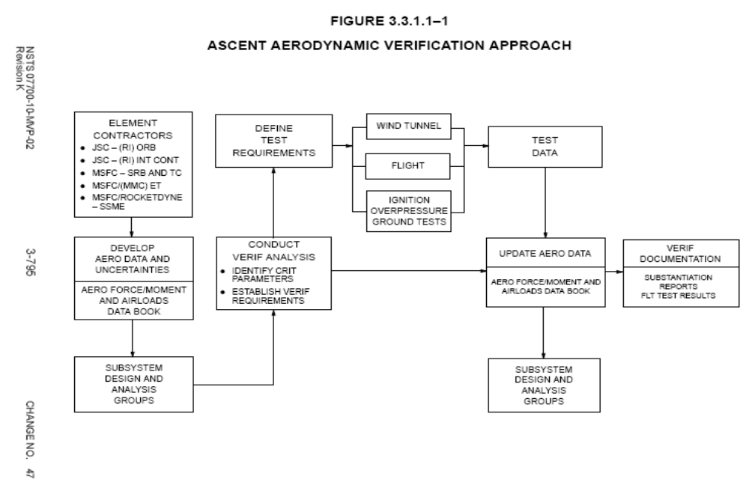
Notes:
This is an example verification network for the aerodynamics of the space shuttle. Note that the network shows the originating point for the aerodynamic data (the contractors) it discusses that the aerodynamic data and the uncertainties for each of the parameters will be developed and documented in a data book. The data book is used by subsystem design and analysis groups to design the vehicle. For example the structures group needed to know how much lift the wings would generate in order to design the wing structure. Then the aerodynamics community conducted analysis to determine what critical parameters in the data book had to be verified by test. The group defined test requirements which were expressed in three major types of aerodynamic testing – these were wind tunnel models, data from flight tests (which included the atmospheric test flights performed by the Enterprise when released from the back of a Boeing 747) and subscale model ignition overpressure tests. It is interesting to note that the subscale overpressure tests (which utilized small rocket motors in models of the shuttle and pad to estimate the effects of ignition on the air pressure on the base of the shuttle) were recognized as important in the initial verification network. When the shuttle Columbia was first launched in 1971, it turned out that these loads were badly underestimated and several parts of the shuttle bent and broke due to these loads. The rest of the verification network diagram shows how after tests, the data book would be evaluated and updated and documentation showing how the data book was verified was produced.
The value to this type of diagram is that it shows everyone how their efforts will work together to accomplish verification of the vehicle performance.

Slide 22
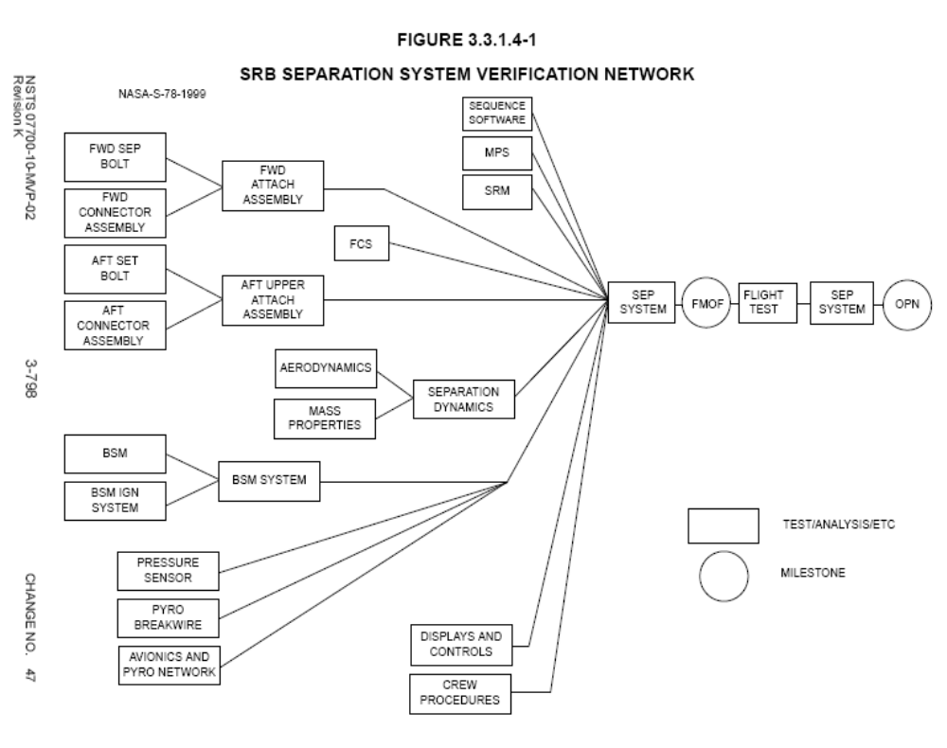
Notes:
This is another diagram from the Shuttle Master Verification Plan. One of the big concerns prior to first flight was that the Solid Rocket Boosters would not properly separate from the tank when they burned out 2 minutes into flight. To verify this function required coordination between mechanical design of attachment fittings, understanding of the Booster Separation Motors (BSMs) which push the boosters away after they burn out, of the aerodynamics and structural dynamics and the performance of the pyrotechnic hardware that exploded to separate the boosters, It can be seen from this diagram that the Flight Control System (FCS) had interactions as did the crew through displays and controls and procedures. The FMOF was the First Manned Orbital Flight which was the only way to really test the function. Because failure of the function would’ve destroyed the vehicle and killed the crew it was vitally important to coordinate everyone’s work to verify each of the pieces and model their integrated performance. This network diagram describes this process and it also shows how the data from the first flight was evaluated to confirm predictions.

Slide 23
Risk Management
In the end, it always comes to the point where it is time to shoot the engineers and go fly the airplane
- Boeing President
In Internet speak – T2SE – Time to Shoot the Engineers

Slide 24
Risk Management
Use a 5x5 matrix to rate – Very Similar To Hazard Analysis
Risk mitigation plans established for yellow and red risks
Allocate resources (money, schedule) to risks –
  RSS resources to avoid having to hold too much in reserve for covering risks – treat each risk as an independent random variable
  Multiply risk resources by probability of risk coming true
Top X list – weekly or monthly review the top risks and their mitigation plans
Reducible vs irreducible risk
  Reducible risks are those where you can work harder to reduce or eliminate them
  Irreducible risks – those were no matter how hard you work, you can’t reduce them
    Good example – combined environments – where you cannot expose an entire flight vehicle structure to the combined thermal, inertial, pressure load simultaneously before you actually fly

Slide 25
Advice on Risk
Irreducible risk – be bold
Reducible risk – be conservative
  Control the things you can
Problem – people say – irreducible risk is greater than reducible so why work so hard on reducible
  Stupid to lose crew/mission for something you could’ve fixed
  Irreducible may be less defined – may not be as large as you or assume
In our history – people generally die from things we could’ve anticipated and fixed

Slide 26
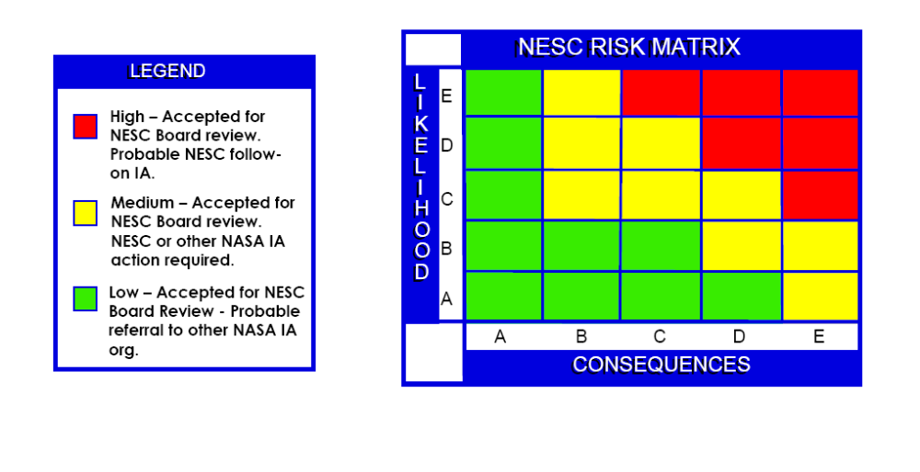
Notes:
This is the NASA Engineering and Safety Center Risk Matrix. It is very similar to the system safety process used for hazard analysis but this may include budget, schedule, political, legal or environmental risks. An IA is an independent assessment.

Slide 27
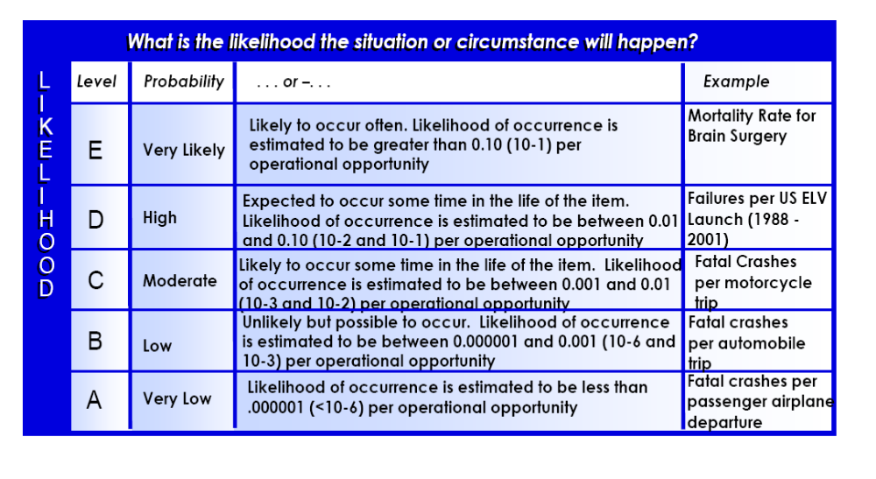
Notes:
These are the likelihood ratings – note these are numerical similar to the DOD standard on hazard analysis

Slide 28
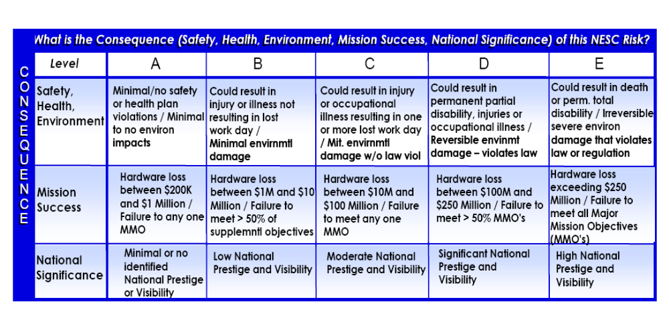
Notes:
This is the consequence matrix. Note the three major categories are:
safety, health and environment – which includes injury and loss of life. This is similar to hazard analysis except that it adds environmental concern
mission success – a political element
National significance – a political element

Slide 29
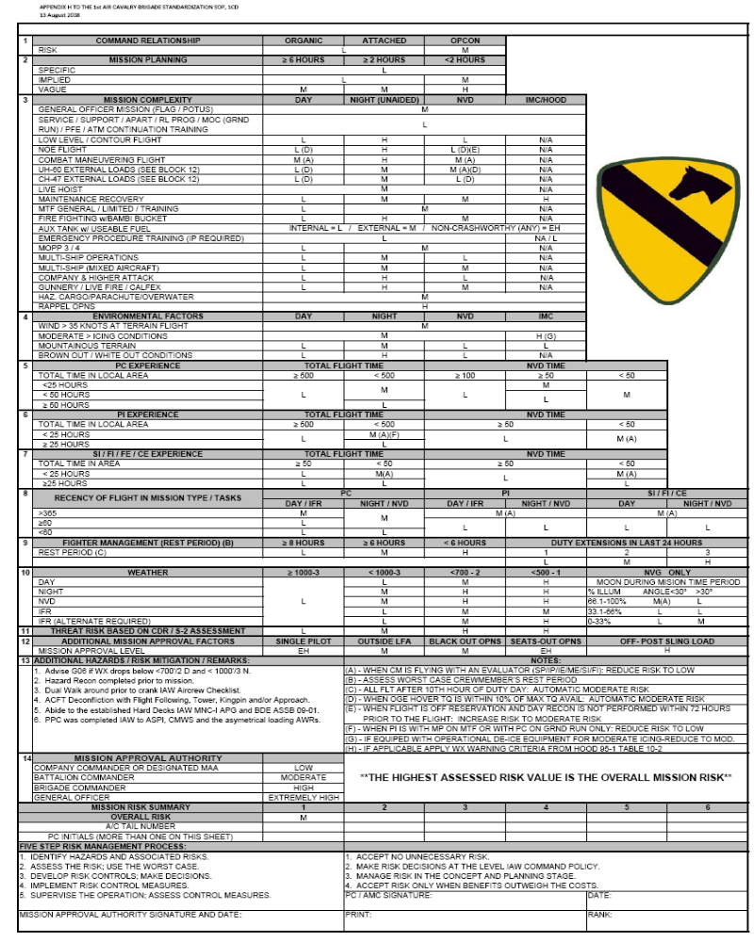
US Army
Pre-mission
Risk Evaluation
For Helicopter Missions
Notes:
This si a risk checklist used by the US Army (in this case the Black Horse Regiment) for evaluating risks prior to executing a helicopter flight. It is required to be performed prior to each flight. It identifies risky activities, such as a load slung below the helicopter) and when the risk score is high enough, the mission must be approved by higher ranking officers.

Slide 30
Any Questions ?

